Slide 1
08/12/2014
Takeaway
Eat - In
Quick Food
18:35:36
DINNER
1
2
3
4
5
6
7
8
9
10
STAFF8
11
12
13
14
15
16
17
18
19
20
21
22
23
24
25
26
27
28
29
30
Cash
Drawer
31
32
33
34
35
36
37
38
39
40
Show
Order
-
-
-
-
-
-
-
-
-
-
-
-
-
-
-
-
-
-
-
-
Control
Panel
-
-
-
-
-
-
-
-
-
-
-
-
-
-
-
-
-
-
-
-
Logout
Billed & Unpaid
Being Processed
Not Used

Slide 2
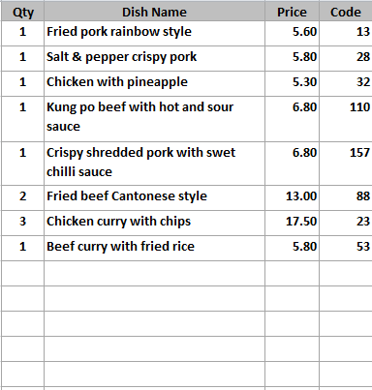
Ref: 2
Mixed hot platter
Mixed hot platter
Mixed hot platter
Mixed hot platter
Duck spring rolls
Duck spring rolls
Duck spring rolls
Duck spring rolls
Beef ginger and
spring onion
Beef ginger and
spring onion
Beef ginger and
spring onion
Beef ginger and
spring onion
Chicken yellow bean
cashew nuts
Chicken yellow bean
cashew nuts
Chicken yellow bean
cashew nuts
Chicken yellow bean
cashew nuts
MENU 1
Roast
Pork
Roast
Pork
Roast
Pork
Roast
Pork
Roast
Pork
SEARCH
MEAL
Szechuan
Szechuan
Szechuan
Szechuan
Szechuan
LANGUAGE
BBQ
Sauce
BBQ
Sauce
BBQ
Sauce
BBQ
Sauce
BBQ
Sauce
11
£67.95
18:48:30
86
+
Remove
Item
CHANGE
REF
NUMBER
Tomato
Tomato
Tomato
Tomato
Tomato
-
KEYPAD
Foo
Yung
Foo
Yung
Foo
Yung
Foo
Yung
Foo
Yung
+ / -
PAY
CANCEL
ORDER
Tray Meal
Tray Meal
Tray Meal
Tray Meal
Tray Meal
Desktop
Tray Meal
Tray Meal
Tray Meal
Tray Meal
Tray Meal

Slide 3
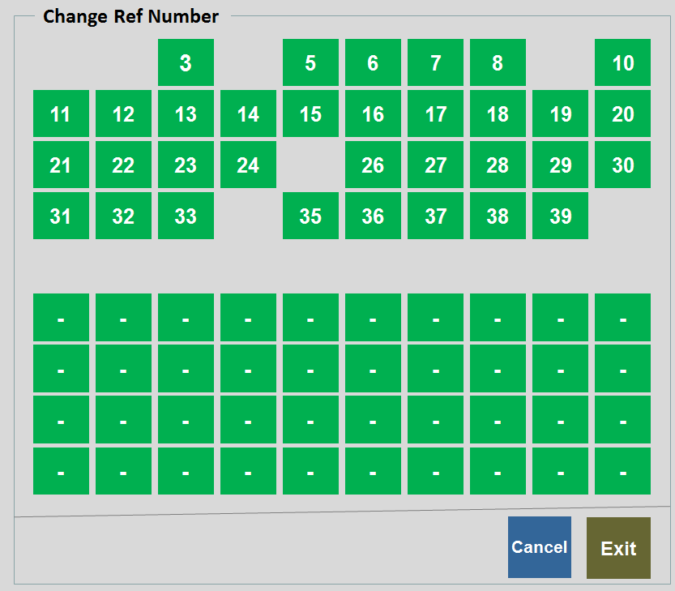
Changing Reference Number
CHANGE
REF
NUMBER
  Change from existing to new reference number

Slide 4
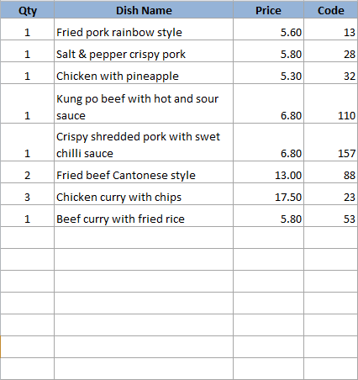
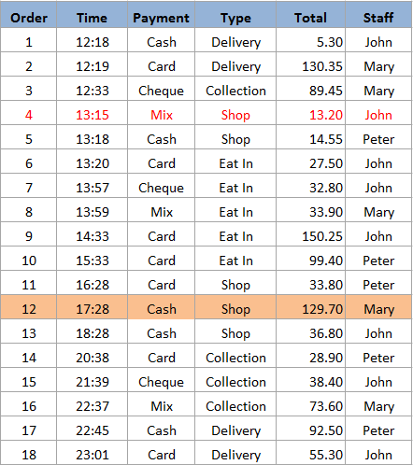
Show Order
Current Time
Current Date
18:35:36
08/12/2014
Print
Receipt
Print
Bill
Print
Kitchen
Paper
Print
Account
Summary
Delivery Charge : 2.50
Show
All
Collect
Delivery
Shop
Eat In
Cust
Info
Discount : 3.80
Surcharge : 1.00
Change
Payment
Edit
Order
Show
Driver
D/C
Exit
Items
11
Total Amount
129.70

Slide 5
Control Panel
System Setting
System
Configuration
User
Maintenance
Data Manager
Compact
Database
Computer
Address
Shift Code
Takeaway & Quick Dining Setting
Takeaway
Configuration
Menu Category
Menu Item
Manage
Menu Set
Extra Menu
Edit
Order Control
Department
Code
Table Setup
Print Setup
Driver
Setup
Eat In Setting
Eat-In
Configuration
Menu Category
Menu Item
Manage
Menu Set
Extra Menu
Edit
Order Control
Department
Code
Table Setup
Printer
Order Entry
Print Setup
Reporting
Account
Summary
Reports
System
Control
Exit

Slide 6
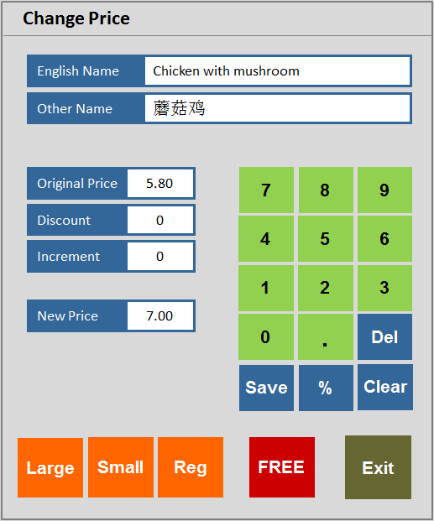
Ref: 2
Mixed hot platter
Mixed hot platter
Mixed hot platter
Mixed hot platter
Duck spring rolls
Duck spring rolls
Duck spring rolls
Duck spring rolls
Beef ginger and
spring onion
Beef ginger and
spring onion
Beef ginger and
spring onion
Beef ginger and
spring onion
Chicken yellow bean
cashew nuts
Chicken yellow bean
cashew nuts
Chicken yellow bean
cashew nuts
Chicken yellow bean
cashew nuts
MENU 1
Roast
Pork
Roast
Pork
Roast
Pork
Roast
Pork
Roast
Pork
SEARCH
MEAL
Szechuan
Szechuan
Szechuan
Szechuan
Szechuan
LANGUAGE
BBQ
Sauce
BBQ
Sauce
BBQ
Sauce
BBQ
Sauce
BBQ
Sauce
11
£67.95
18:48:30
86
+
Remove
Item
CHANGE
REF
NUMBER
Tomato
Tomato
Tomato
Tomato
Tomato
-
KEYPAD
Foo
Yung
Foo
Yung
Foo
Yung
Foo
Yung
Foo
Yung
+ / -
PAY
CANCEL
ORDER
Tray Meal
Tray Meal
Tray Meal
Tray Meal
Tray Meal
Desktop
Tray Meal
Tray Meal
Tray Meal
Tray Meal
Tray Meal

Slide 7
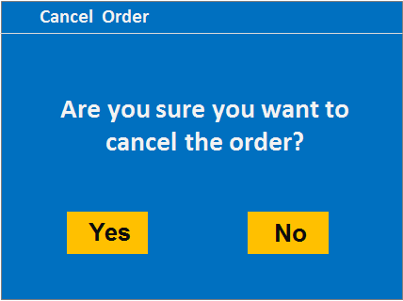
Ref: 2
Mixed hot platter
Mixed hot platter
Mixed hot platter
Mixed hot platter
Duck spring rolls
Duck spring rolls
Duck spring rolls
Duck spring rolls
Beef ginger and
spring onion
Beef ginger and
spring onion
Beef ginger and
spring onion
Beef ginger and
spring onion
Chicken yellow bean
cashew nuts
Chicken yellow bean
cashew nuts
Chicken yellow bean
cashew nuts
Chicken yellow bean
cashew nuts
MENU 1
Roast
Pork
Roast
Pork
Roast
Pork
Roast
Pork
Roast
Pork
SEARCH
MEAL
Szechuan
Szechuan
Szechuan
Szechuan
Szechuan
LANGUAGE
BBQ
Sauce
BBQ
Sauce
BBQ
Sauce
BBQ
Sauce
BBQ
Sauce
11
£67.95
18:48:30
86
+
Remove
Item
CHANGE
REF
NUMBER
Tomato
Tomato
Tomato
Tomato
Tomato
-
KEYPAD
Foo
Yung
Foo
Yung
Foo
Yung
Foo
Yung
Foo
Yung
+ / -
PAY
CANCEL
ORDER
Tray Meal
Tray Meal
Tray Meal
Tray Meal
Tray Meal
Desktop
Tray Meal
Tray Meal
Tray Meal
Tray Meal
Tray Meal

Slide 8
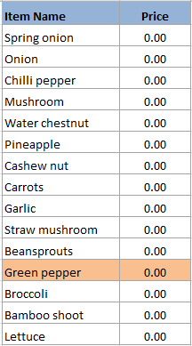
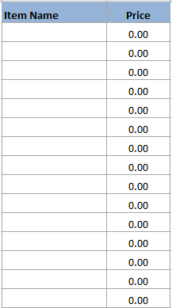
Taste Handling
Taste Item
Drink Item
Vegetable
LESS
Vegetable 2
Bean
ADD
Meat
Seafood
WITHOUT
Select From
Main Menu
Sauce
CHANGE
Taste
Fruit
Cooking
Others
Clear
Exit

Slide 9
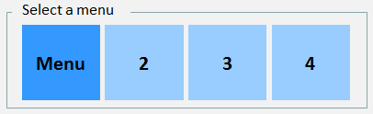
Ref: 2
Mixed hot platter
Mixed hot platter
Mixed hot platter
Mixed hot platter
Duck spring rolls
Duck spring rolls
Duck spring rolls
Duck spring rolls
Beef ginger and
spring onion
Beef ginger and
spring onion
Beef ginger and
spring onion
Beef ginger and
spring onion
Chicken yellow bean
cashew nuts
Chicken yellow bean
cashew nuts
Chicken yellow bean
cashew nuts
Chicken yellow bean
cashew nuts
MENU 1
Roast
Pork
Roast
Pork
Roast
Pork
Roast
Pork
Roast
Pork
SEARCH
MEAL
Szechuan
Szechuan
Szechuan
Szechuan
Szechuan
LANGUAGE
BBQ
Sauce
BBQ
Sauce
BBQ
Sauce
BBQ
Sauce
BBQ
Sauce
11
£67.95
18:48:30
86
+
Remove
Item
CHANGE
REF
NUMBER
Tomato
Tomato
Tomato
Tomato
Tomato
-
KEYPAD
Foo
Yung
Foo
Yung
Foo
Yung
Foo
Yung
Foo
Yung
+ / -
PAY
CANCEL
ORDER
Tray Meal
Tray Meal
Tray Meal
Tray Meal
Tray Meal
Desktop
Tray Meal
Tray Meal
Tray Meal
Tray Meal
Tray Meal

Slide 10
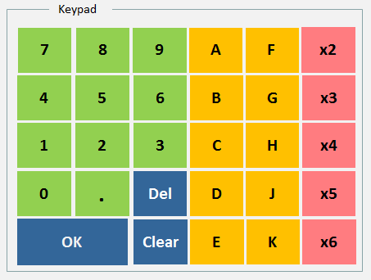
Ref: 2
Mixed hot platter
Mixed hot platter
Mixed hot platter
Mixed hot platter
Duck spring rolls
Duck spring rolls
Duck spring rolls
Duck spring rolls
Beef ginger and
spring onion
Beef ginger and
spring onion
Beef ginger and
spring onion
Beef ginger and
spring onion
Chicken yellow bean
cashew nuts
Chicken yellow bean
cashew nuts
Chicken yellow bean
cashew nuts
Chicken yellow bean
cashew nuts
MENU 1
Roast
Pork
Roast
Pork
Roast
Pork
Roast
Pork
Roast
Pork
SEARCH
MEAL
Szechuan
Szechuan
Szechuan
Szechuan
Szechuan
LANGUAGE
BBQ
Sauce
BBQ
Sauce
BBQ
Sauce
BBQ
Sauce
BBQ
Sauce
11
£67.95
18:48:30
86
+
Remove
Item
CHANGE
REF
NUMBER
Tomato
Tomato
Tomato
Tomato
Tomato
-
KEYPAD
Foo
Yung
Foo
Yung
Foo
Yung
Foo
Yung
Foo
Yung
+ / -
PAY
CANCEL
ORDER
Tray Meal
Tray Meal
Tray Meal
Tray Meal
Tray Meal
Desktop
Tray Meal
Tray Meal
Tray Meal
Tray Meal
Tray Meal

Slide 11
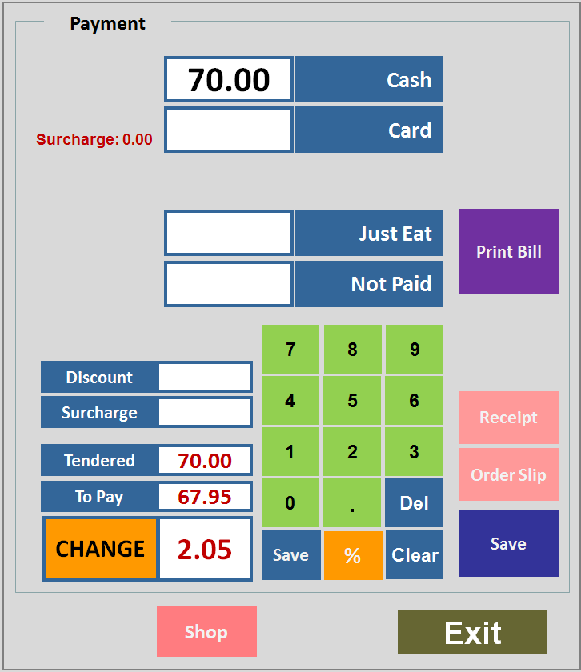
Ref: 2
Mixed hot platter
Mixed hot platter
Mixed hot platter
Mixed hot platter
Duck spring rolls
Duck spring rolls
Duck spring rolls
Duck spring rolls
Beef ginger and
spring onion
Beef ginger and
spring onion
Beef ginger and
spring onion
Beef ginger and
spring onion
Chicken yellow bean
cashew nuts
Chicken yellow bean
cashew nuts
Chicken yellow bean
cashew nuts
Chicken yellow bean
cashew nuts
MENU 1
Roast
Pork
Roast
Pork
Roast
Pork
Roast
Pork
Roast
Pork
SEARCH
MEAL
Szechuan
Szechuan
Szechuan
Szechuan
Szechuan
LANGUAGE
BBQ
Sauce
BBQ
Sauce
BBQ
Sauce
BBQ
Sauce
BBQ
Sauce
11
£67.95
18:48:30
86
+
Remove
Item
CHANGE
REF
NUMBER
Tomato
Tomato
Tomato
Tomato
Tomato
-
KEYPAD
Foo
Yung
Foo
Yung
Foo
Yung
Foo
Yung
Foo
Yung
+ / -
PAY
CANCEL
ORDER
Tray Meal
Tray Meal
Tray Meal
Tray Meal
Tray Meal
Desktop
Tray Meal
Tray Meal
Tray Meal
Tray Meal
Tray Meal

Slide 12

Changing Quick Food order to Takeaway
  Change it to a takeaway order

Slide 13
END
(Slides beyond this page are for references only)

Slide 14
Payment
70.00
Cash
Card
Surcharge: 0.00
Just Eat
Print Bill
Not Paid
7
8
9
Discount
4
5
6
Receipt
Surcharge
1
2
3
Tendered
70.00
Order Slip
To Pay
67.95
0
.
Del
CHANGE
2.05
Save
Save
%
Clear
Shop
Exit

Slide 15
Payment
20.00
Cash
Card
Print Bill
Surcharge: 0.00
Credit Card
Receipt
Cheque
Order Slip
7
8
9
Discount
20.00
4
5
6
Save
Print Dept.
Surcharge
0.00
1
2
3
Tendered
20.00
To Pay
8.50
0
.
Del
CHANGE
11.50
Exit
Save
%
Clear

